Slide 1

Neural Substrates of Attention and Awareness
Dan Birman
Gardner Lab
Lightning Talks – 2015-04-23

Slide 2
Is attention necessary
for awareness?
Notes:
This project starts with a question: “Is attention necessary for awareness?“ A lot of people have asked this before—let me demonstrate some of the answers that they have arrived at.

Slide 3

Notes:
Here is a classic task that is known to be very attentionally demanding: search for an L among this display of Ts. I’m going to flash another display up in a moment, don’t blink.

Slide 4
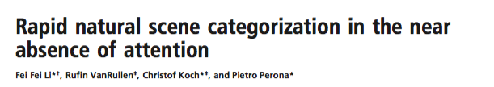
Notes:
So an unexpected event happened: a scene appeared, but most of the people in the audience probably felt like they knew this was an image of a city and not some other location.

Slide 5
Is attention necessary
for awareness?
No: Attention to characters doesn’t affect scene perception
Notes:
So for that example, the answer was no.

Slide 6

Notes:
Let’s try a different example now. I want you to pay attention to motion and count the planes as they cross the screen.

Slide 7

Notes:
Ready? Here we go.
Now, you were directing your attention at motion, and in the background you were unaware of several changes that happened. Let me highlight them and then switch back to the original image.

Slide 9
Is attention necessary
for awareness?
No: Attention to characters doesn’t affect scene perception
Yes: Attention to motion does affect scene perception
Notes:
So we have a paradox, in some situations attention seems to be essential and in others its unnecessary!
I think the problem here is that attention feels like its always one process, even though that isn’t true.

Slide 10
Attention is a neural process
Notes:
The problem with those demonstrations and their thought process is that they don’t think about the process of attention—which is implemented via sensory enhancement in the cortex.

Slide 11
Attention is a neural process
To predict the effect of attention, we can turn to physiology:
How are two neural representations connected?
Notes:
Importantly, the effect of attention on one feature will influence others, but only to the extent that they are connected.
Lets look at two well understood examples

Slide 12
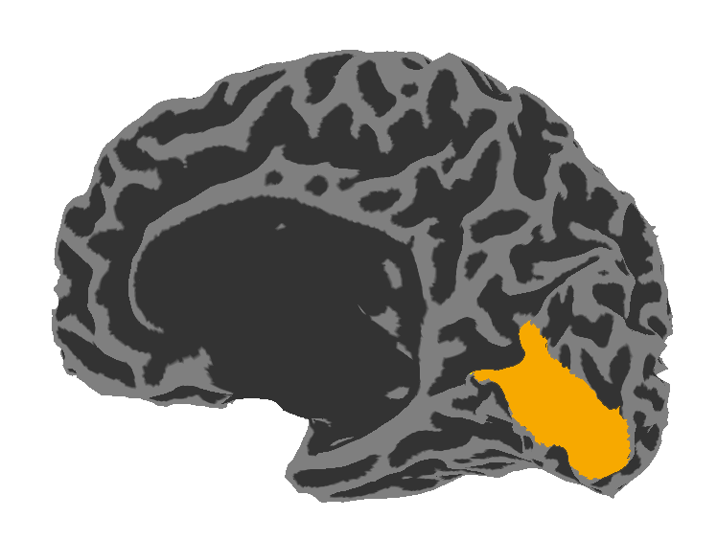
High Contrast
Low Contrast
Visual Area V1: Contrast
Notes:
We know that the neural response in cortical area V1 is sensitive to the intensity of contrast
And that attention to contrast influences those responses.

Slide 13
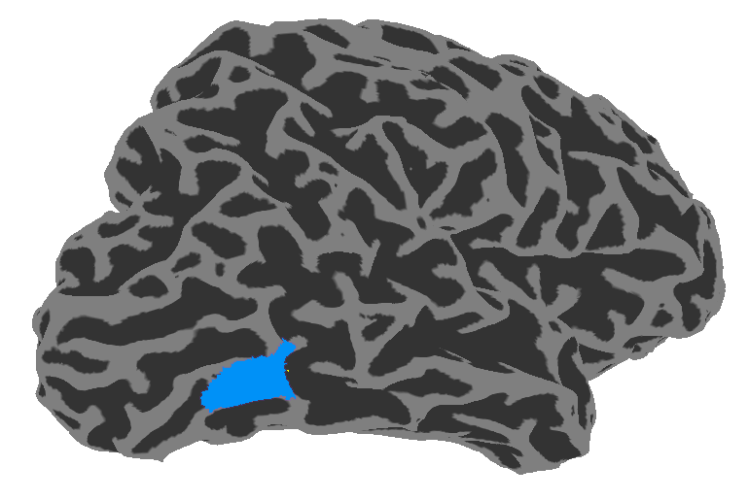


High Contrast
Low Contrast
Visual Area V1: Contrast
Visual Area hMT: Motion
0% Coherence
100% Coherence
Notes:
We also know that the responses in cortical area MT are sensitive to motion, which we manipulate with motion coherence.
Again, responses in MT are modulated by attention to motion.

Slide 14
V1 and MT are organized hierarchically
We should expect hierarchical effects in behavior:
contrast should affect motion
Notes:
We also know that V1 and MT are connected and organized hierarchically.
So behavioral effects should also be hierarchical: contrast should affect motion!

Slide 15
Contrast / Motion Discrimination Task
Task used to estimate the ‘just noticeable difference’ as a % intensity
500 ms stimulus
+ 250 ms mask
Response:
Left / Right
Attend to one feature for 100 trials per block
Notes:
I won’t go into all of the details, but we designed a task that mimics the demonstrations
while attending to a feature we can estimate how much intensity you need to ‘just notice a difference’

Slide 16
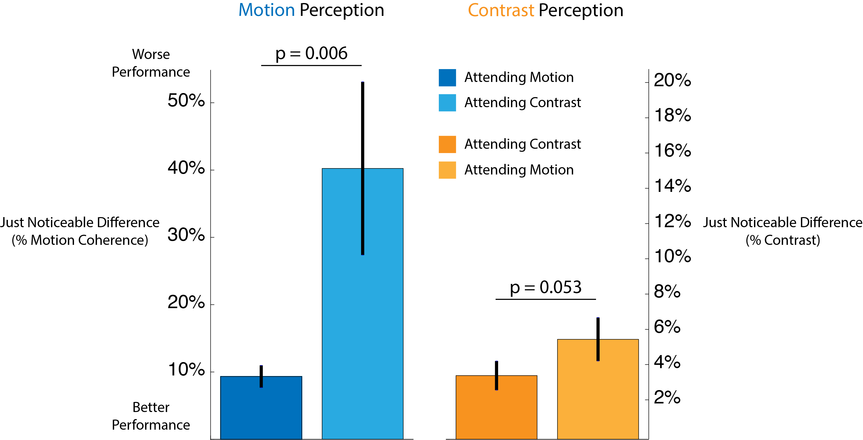
Attention
Notes:
So what is your just noticeable difference for motion perception, when you are attending to motion?

Slide 17
Attention
Notes:
10%! (Not a lot)

Slide 18
Attention
Notes:
Your JND for contrast is ~4%
Now we played a trick on participants: there were unexpected trials where they were still attending to contrast, but they were asked to respond about motion perception

Slide 19
Attention
Notes:
On those trials their JND was 40%!

Slide 20
Attention
Notes:
But surprisingly, there was an asymmetry with contrast perception—where the JND didn’t change much, if at all.

Slide 21
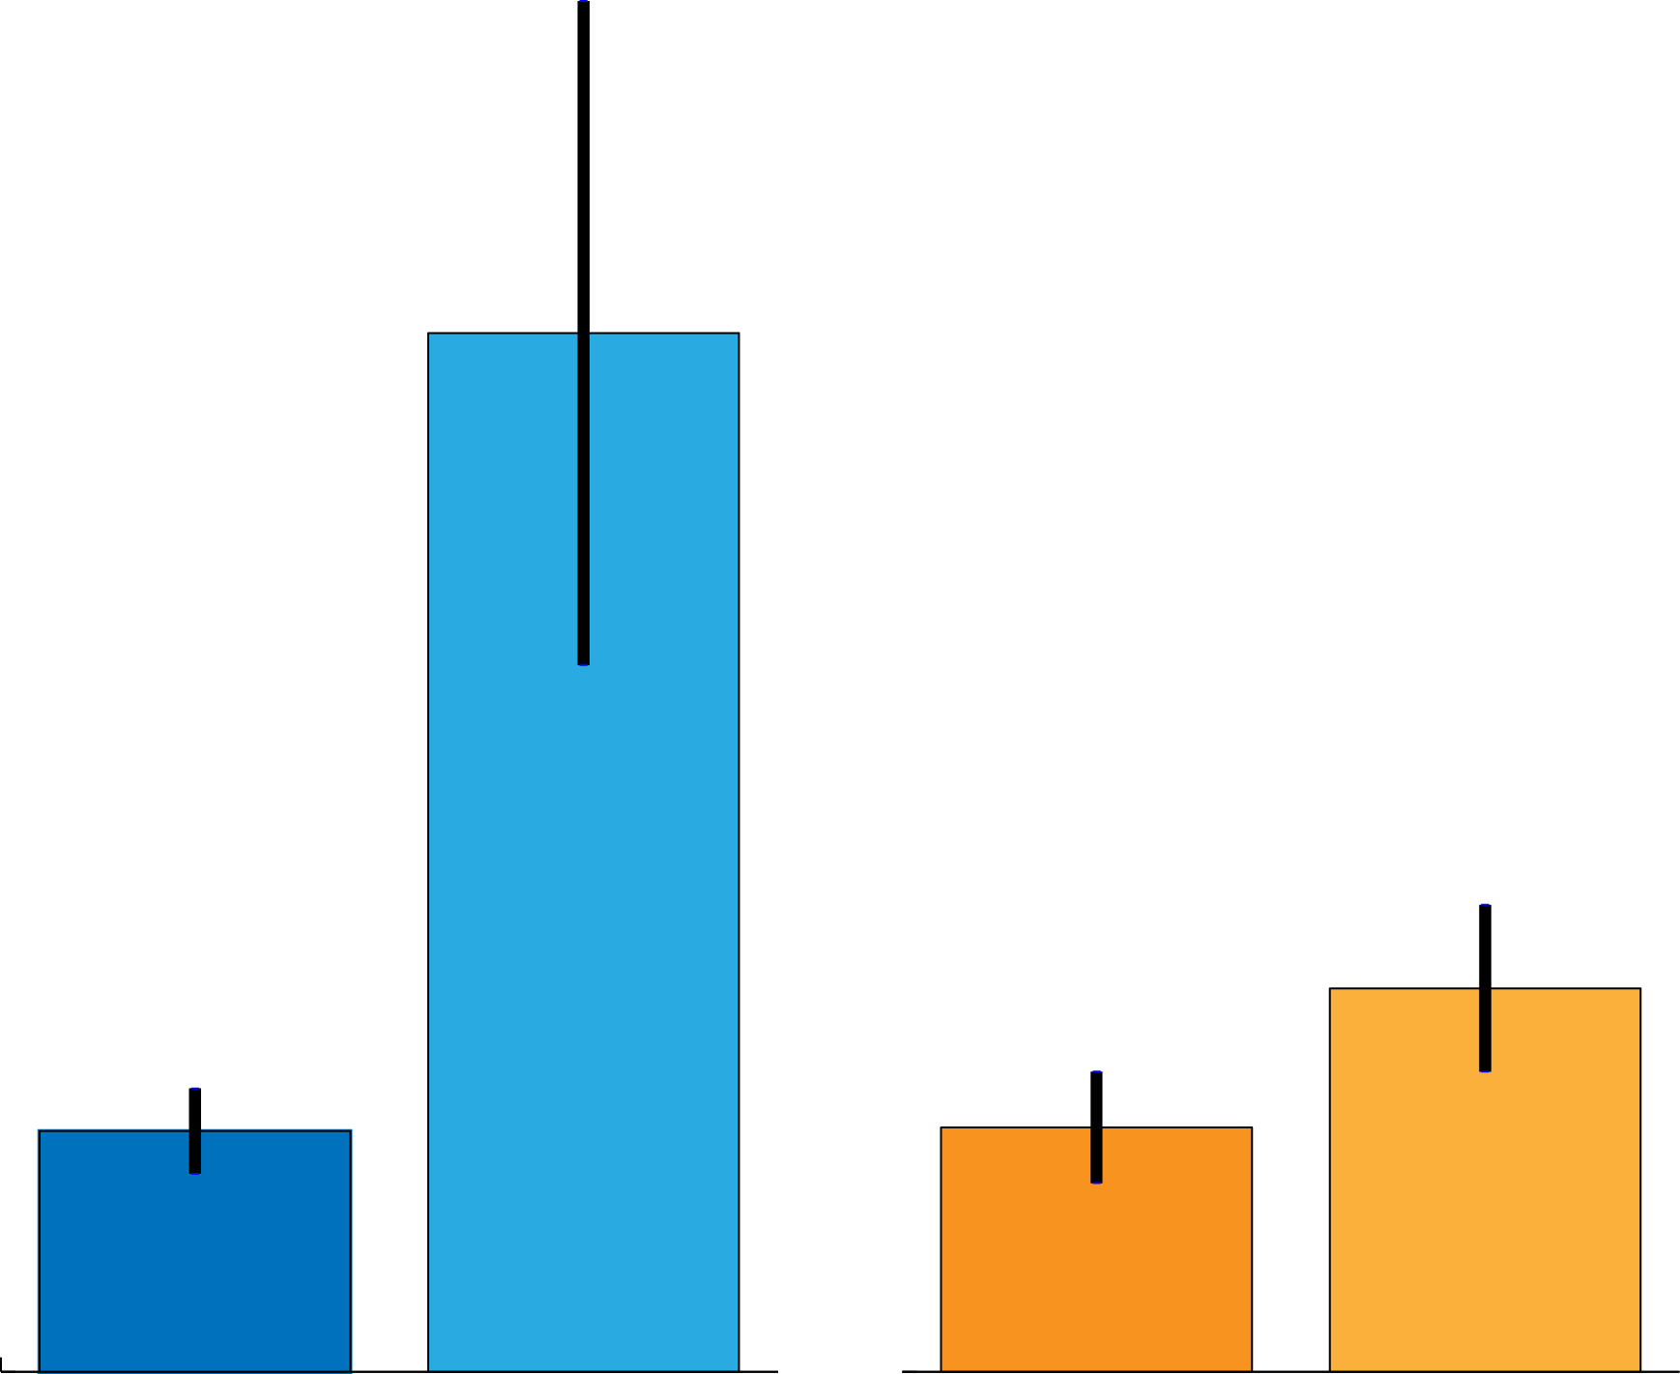
V1 and MT are organized hierarchically
Attention
Notes:
So motion perception was affected! As predicted—
When you change attention to motion

Slide 22
V1 and MT are organized hierarchically
Attention
Notes:
To attention to contrast, there is a large behavioral effect

Slide 23

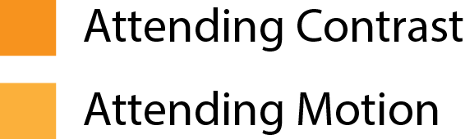
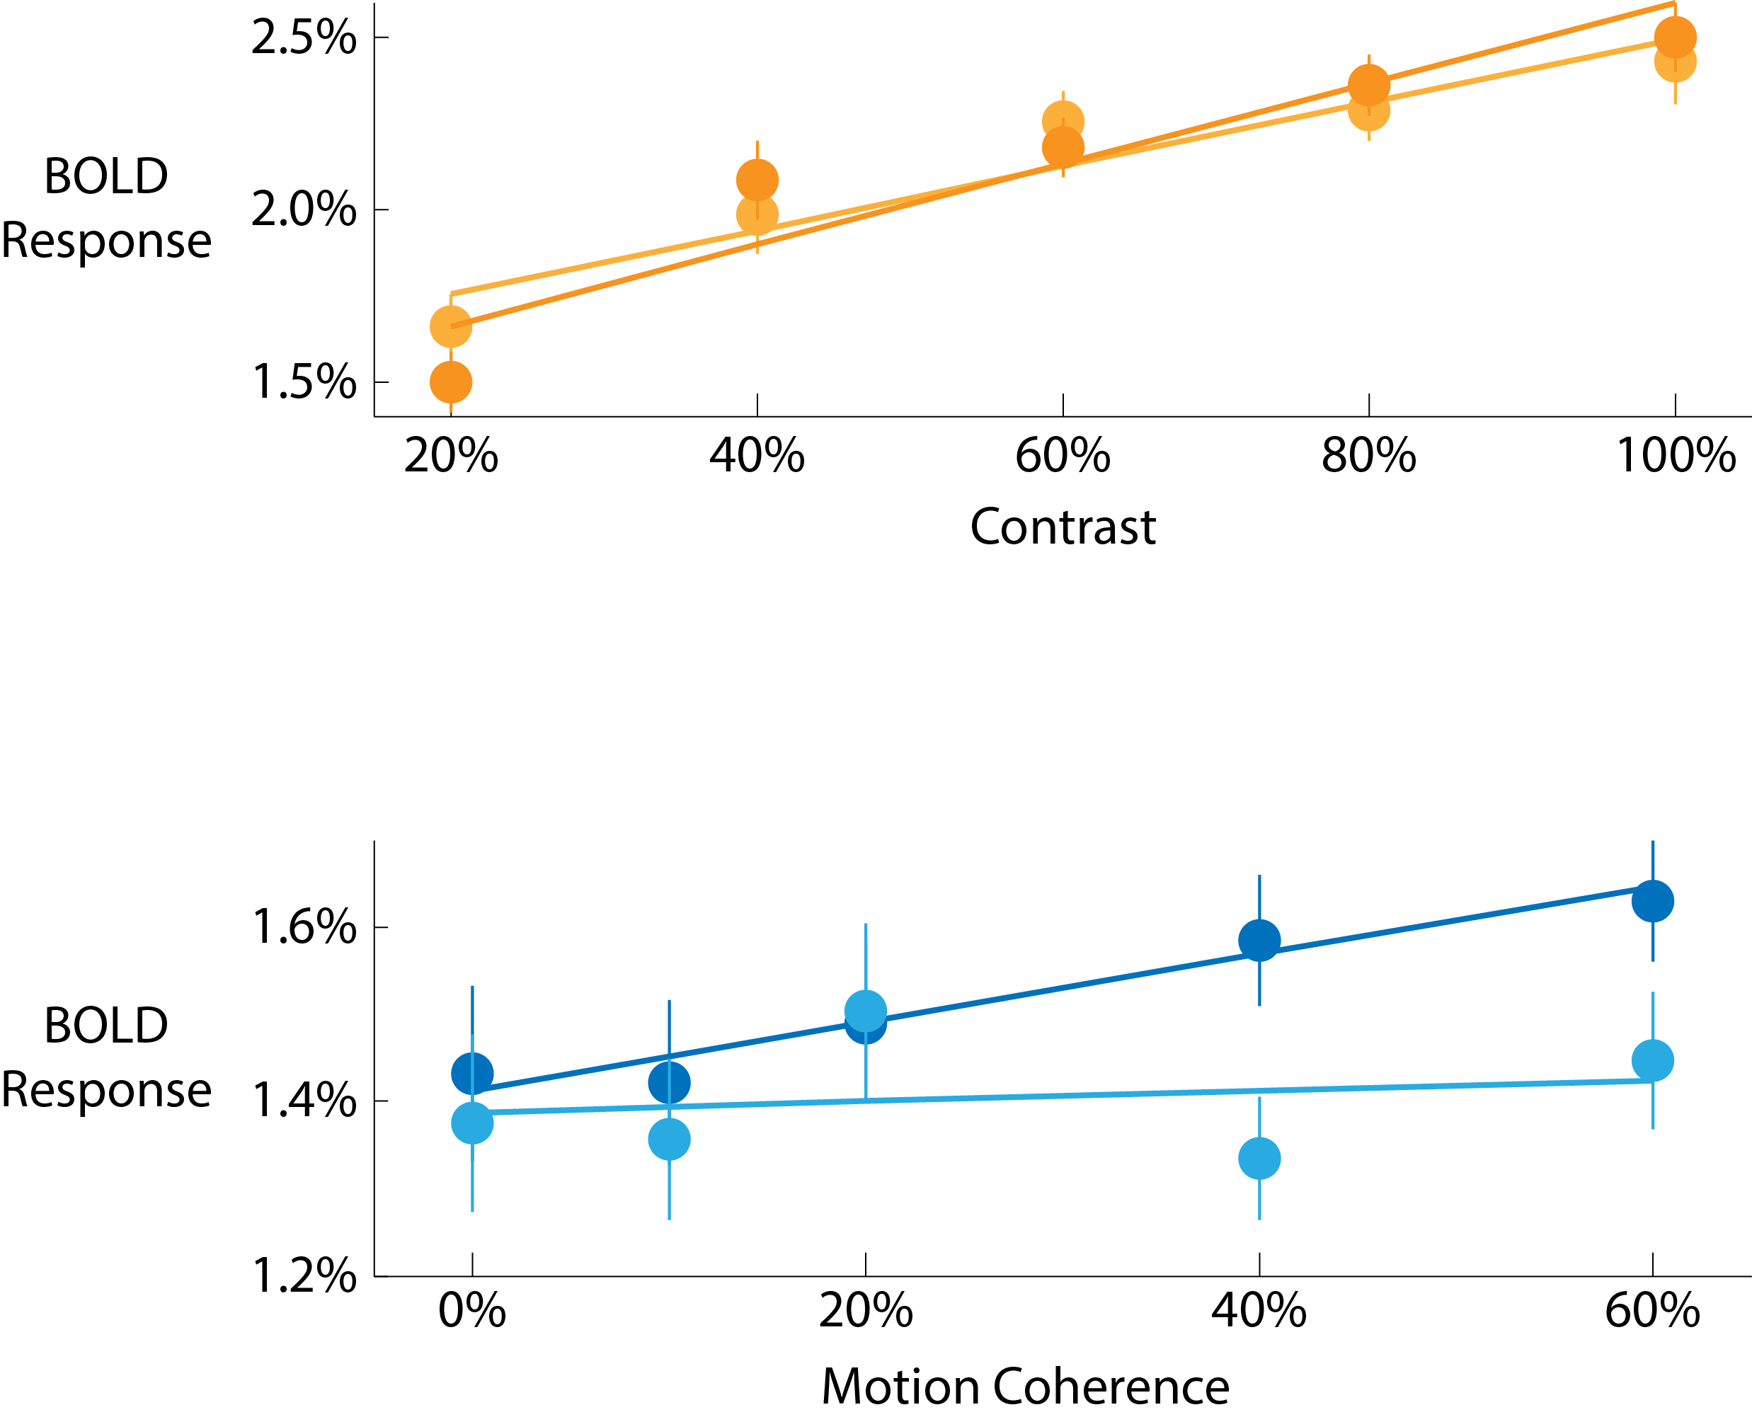


Notes:
OF course while performing the task we collected physiological responses, and (Without going into detail) these suggest that the pattern we observed makes sense, the response to motion is suppressed when you are attending to contrast.

Slide 24
Is Attention necessary for Awareness?
Notes:
So to come back to the original question: Is attention necessary for awareness?

Slide 25
It depends!
Is Attention necessary for Awareness?
Interactions occur where strong connections exist between neural representations
Notes:
The answer is—it depends!

Slide 26
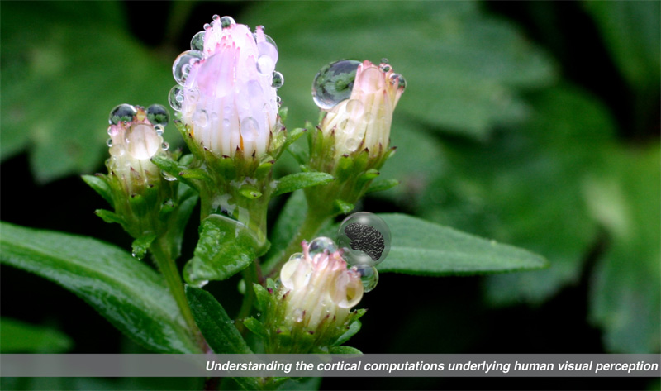

Gardner Lab @ Stanford University
Justin Gardner
Notes:
Thank you!

